Slide 1
K-NEAREST NEIGHBORS

Slide 2
k-nearest neighbors
KNN Intitution
Compare the two data points, distance metric
How to choose a K
Implement KNN from scratch
Implement KNN on Iris data set with Scikit Learn
Use KNN as Regression
Exercise : Apply KNN on MNIST Data

Slide 3
KNN INTITUTION

Slide 4
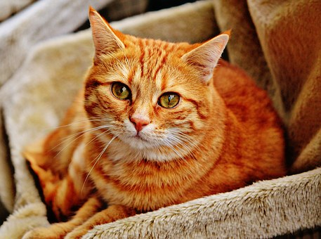

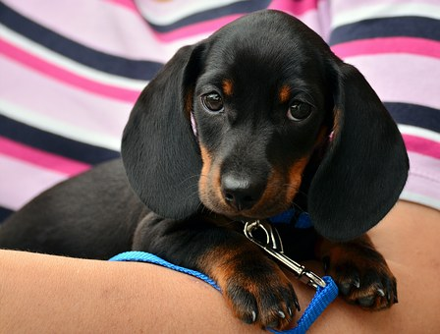
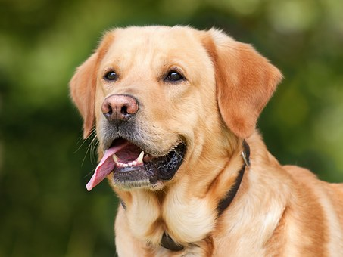
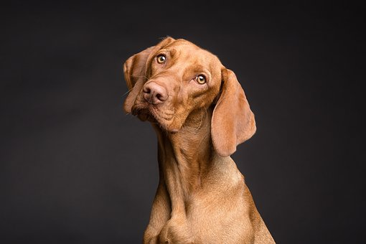
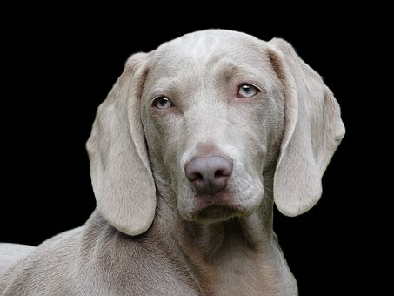
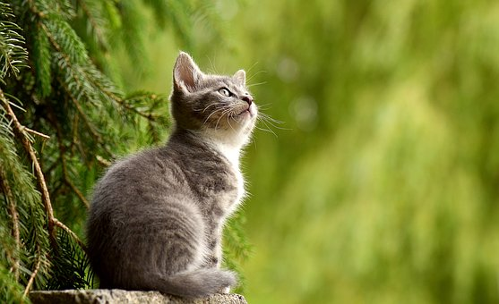


Problem
Classification Problem –
Dog or Cat

Slide 5
Visualize KNN
K = 3
K = 5

Slide 6
KNN Algorithm
Choose K
Find Distance with all point from test point
Sort Distance
Select K point with Minimum distance
Classify in majority vote

Slide 7
Question Arise
How many K – nearest neighbor
How to Compare

Slide 8
How many K

Slide 9
Error vs K-value

Slide 10
How to Compare

Slide 11
Distance Measure
$$Euclidien Distance=\sqrt{{(x1− x2)}^{2}+{(y1− y2)}^{2}}$$
“euclidean” | EuclideanDistance | sqrt(sum((x - y)^2))
“manhattan” | ManhattanDistance | sum(|x - y|)
“chebyshev” | ChebyshevDistance | max(|x - y|)
“minkowski” | MinkowskiDistance | sum(|x - y|^p)^(1/p)
“wminkowski” | WMinkowskiDistance | sum(|w * (x - y)|^p)^(1/p)
“seuclidean” | SEuclideanDistance | sqrt(sum((x - y)^2 / V))
“mahalanobis” | MahalanobisDistance | sqrt((x - y)' V^-1 (x - y))
Source : http://scikit-learn.org/stable/modules/generated/sklearn.neighbors.DistanceMetric.html

Slide 12
Some Aspect of KNN
Lazy learner
Instance Based
Just memorization of Data
Easy interpretation of result
Performance on Read world data – not very good
Computational cost very high for big dataset
Non-parametric in nature

Slide 13
IMPLEMENT KNN FROM SCRATCH

Slide 14
Steps
Importing Library and Load Data
Normalize Data - scaling
Split data – Train Test
Apply KNN on 1 Test Sample
Accuracy

